Slide 1

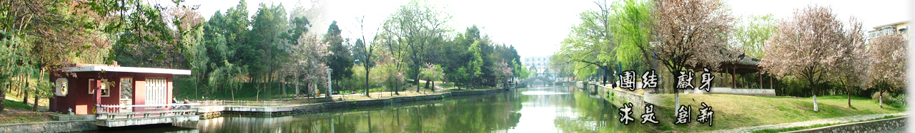
11 Sequential Bayesian Inference
（序贯贝叶斯推理）
EOE Postgraduate Courses
Multi-sensor Data Fusion
wangjingqi@njust.edu.cn

Slide 2
Contents
11.1 Introduction
11.2 Recursive Filter
11.3 Kalman Filter
11.4 Extensions of Kalman Filter
11.5 Particle Filter
11.6 Multi-Sensor Multi-Temporal Data Fusion

Slide 3
11.1 Introduction
Sequential Bayesian inference（序贯贝叶斯推理） —— consider the Bayesian estimation of a dynamic system which is changing in time.
θ_{k} —— the state of the system at some (discrete) time k.
to estimate the a posteriori pdf p(θ_{k}|y_{1:l}, I), by fusing together a sequence of sensor measurements y_{1:l} = (y₁, y₂, . . . , y_{l}).
(sequential) Bayesian filtering —— only consider the calculation of pdf p(θ_{k}|y_{1:l}, I) for k = l .
multi-temporal data fusion （多时相信息融合）—— the measurements are all made by the same sensor.
Multi-sensor multi-temporal data fusion（多传感器多时相信息融合）—— measurements are made by more than one sensor.

Slide 4
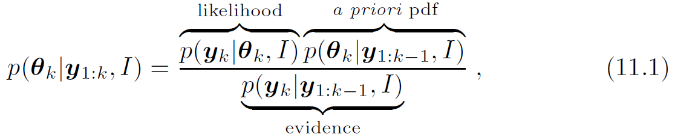
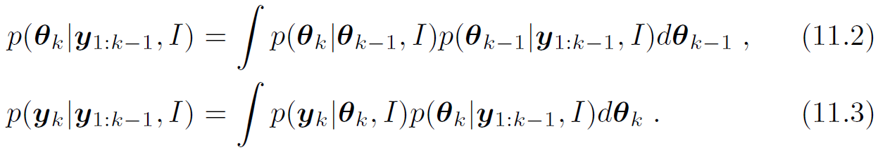
Estimation of p(θ_{k}|y_{1:k}, I) using a recursive formulation of Bayes’ theorem: （贝叶斯定理的递归形式 ）
where
（先验概率分布的积分式）
（证据的积分式）
(sequential) Bayesian filtering: At each time step only the current sensor measurement y_{k}, is used and it is not necessary to maintain, or re-process, previous measurements.
The main difficulty in calculating p(θ_{k}|y_{1:k}, I) involves solving the integrals defined in (11.2) and (11.3).

Slide 5
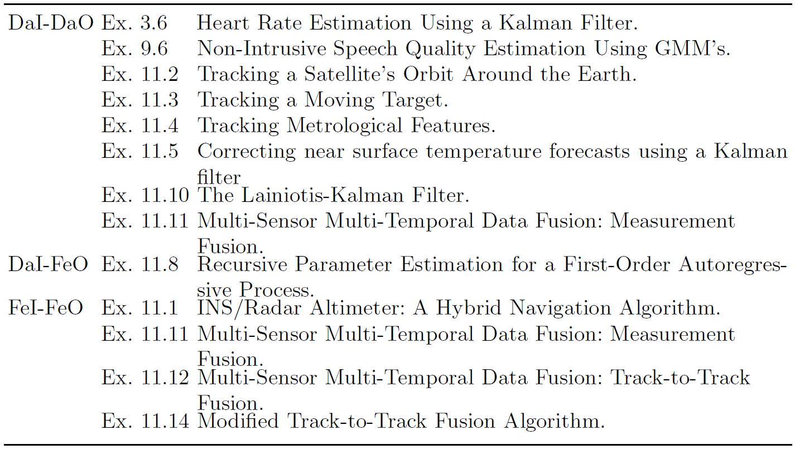
Table 11.1. Applications in which the Sequential Filter is the Primary Fusion Algorithm

Slide 6
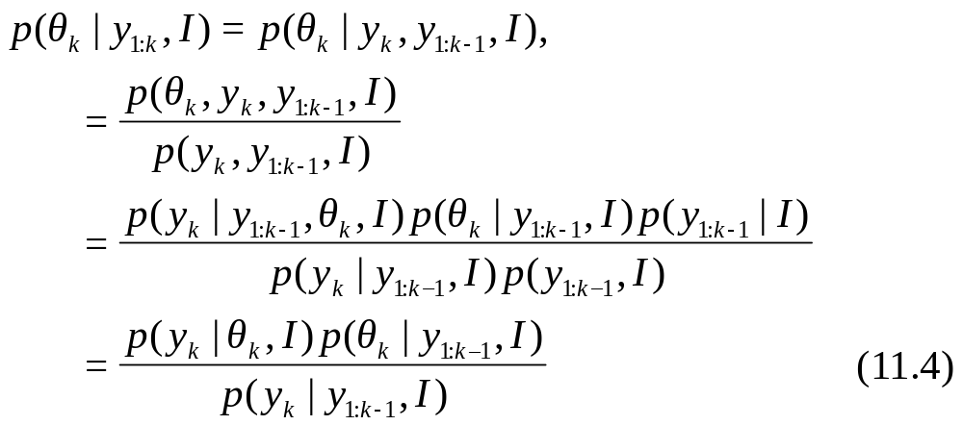
11.2 Recursive Filter（递归滤波器的推导）
Eq. (11.1) represents a recursive formulation of Bayes’ theorem. It is obtained by applying Bayes’ theorem to the last measurement in p(θ_{k}|y_{1:l}, I):
where y_{k} obey a Markov measurement model
y_{k} is independent of the previous states θ_{1: k-1} and the previous measurements y_{1: k-1} .

Slide 7
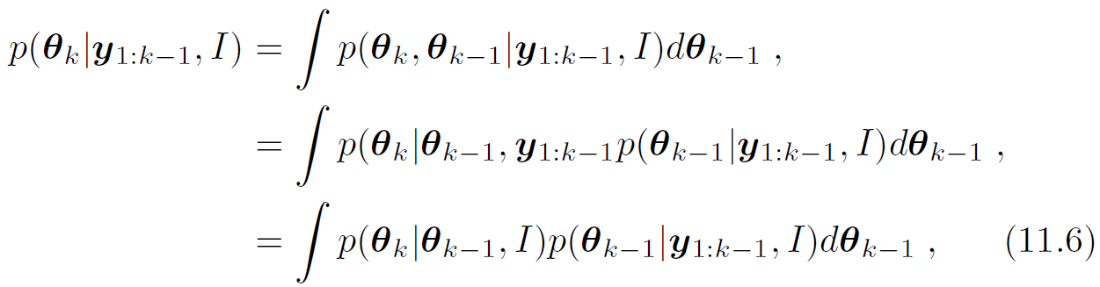
2. Eq. (11.2) represents an integral formulation of the a priori pdf. （It is obtained by marginalizing θ_{k−1} out of the joint pdf p(θ_{k}, θ_{k−1} |y_{1:k−1}, I):
where θ_{k} obey a Markov process model (the θ_{k} depends only on θ_{k -1} ):
3. Eq. (11.3) represents an integral formulation of the Bayesian evidence. It follows directly from the definition of evidence which acts as a normalization factor in Bayes’ rule.

Slide 8
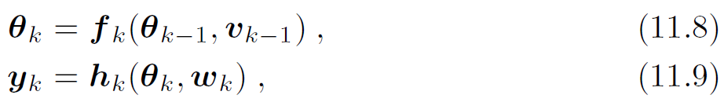
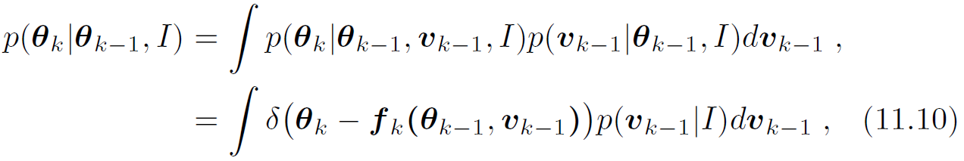
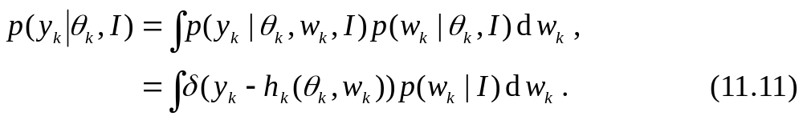
Markov process and measurement models as stochastic equations
where v_{k−1} is a noise term in the system and w_{k} is a noise term in the measurement process.
Substituting (11.8) in (11.2) gives
Substituting (11.9) in (11.3) gives

Slide 9
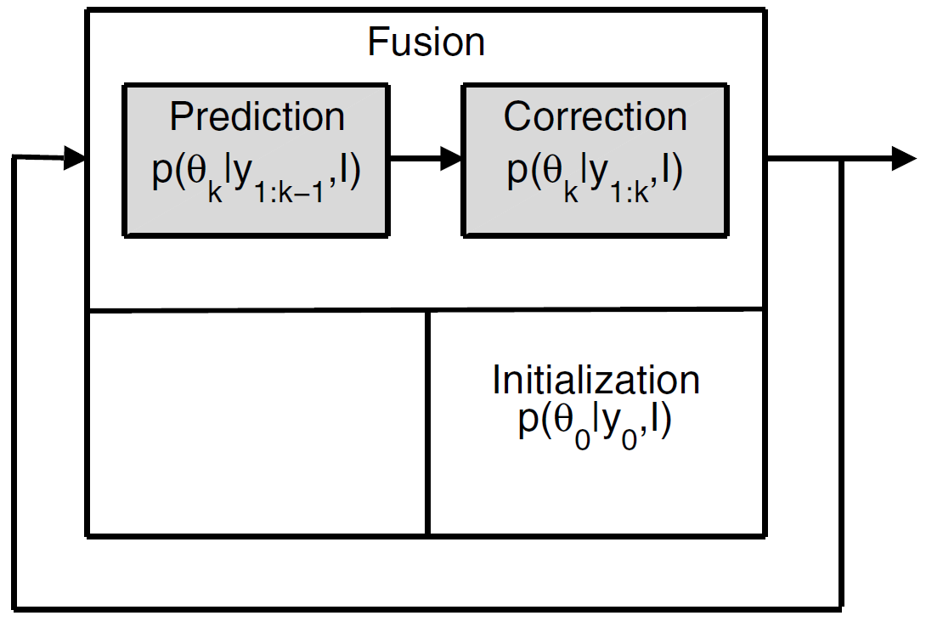
Main processing steps in the Bayesian recursive filter
the iterative fusion cell
Initialization. Specify an a priori pdf, p(θ₀|y₀, I), where y₀ denotes that no measurements have been made.
Prediction. Calculate a predicted pdf p(θ_{k}|y_{1:k−1}, I) using the process model θ_{k} = f_{k−1}(θ_{k−1}, v_{k−1}) and the p(θ_{k-1}|y_{1:k−1}, I) .
Correction. Calculate the a posteriori pdf p(θ_{k}|y_{1:k−1}, I) by correcting the predicted pdf using y_{k} → p(θ_{k}|y_{1:k}, I)

Slide 10
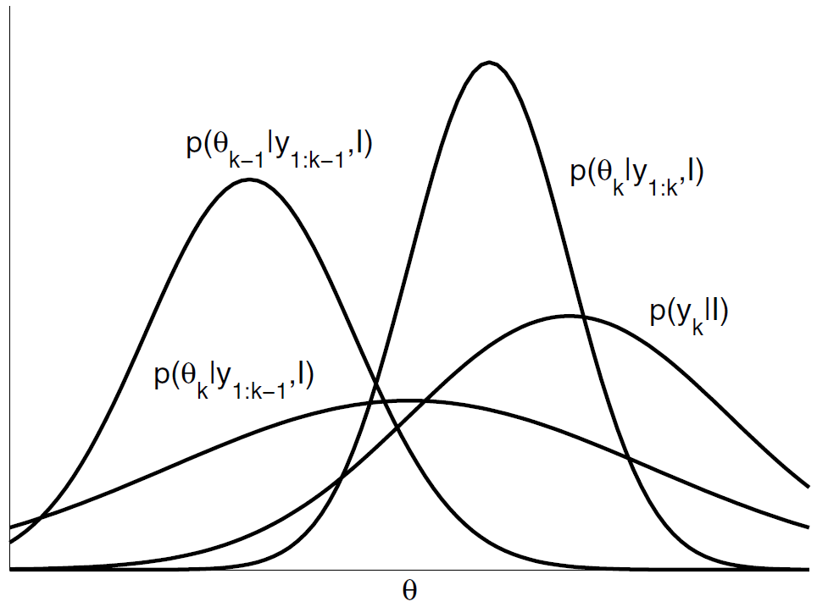
Shapes of the different probability distributions in a recursive filter
Fig. 11.2. The shapes of the different probability distributions in a generic
recursive filter.

Slide 11
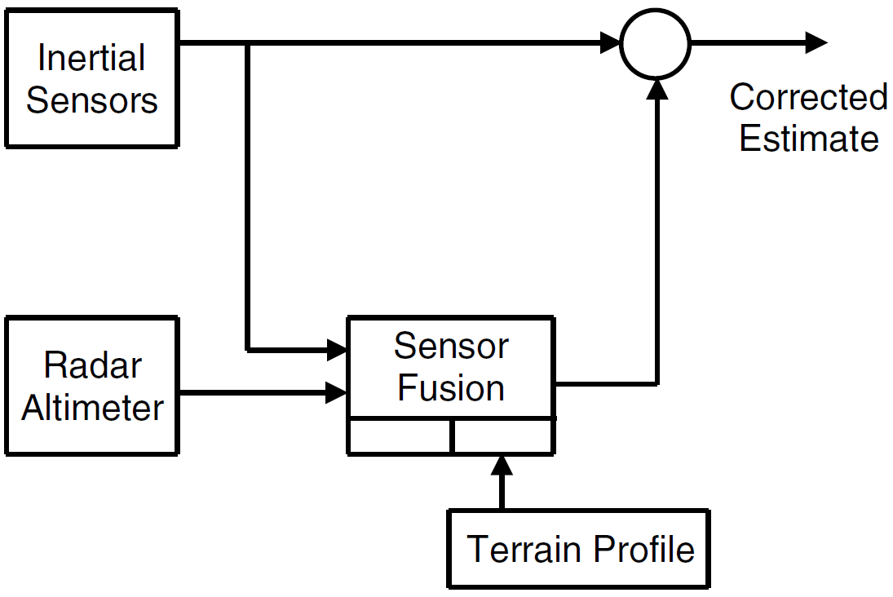
Example 11.1. INS/Radar Altimeter: A Hybrid Navigation Principle.
Terrain-aided navigation —— radar altimeter measurements combined with inertial measurements (INS)
At each time step k, use the INS measurements (accelerometer and gyro-meter) to compute the INS estimate θ_{k}.
Fuse θ_{k} with the radar altimeter measurements y_{k} → the INS drift δθ_{k} (i. e. error in θ_{k} ) used to correct θ_{k} .

Slide 12



Hybrid navigation algorithm
Write the INS estimate at time step k as a linear Gaussian equation:
θ_{k} — INS estimates (latitude, longitude, altitude, roll, pitch, yaw and speed) ；v_{k−1} ∼ N(0,Q_{k−1}) — the noise vector in θ_{k−1}.
Scalar radar altimeter measurement equation:
l_{k}, L_{k} and z_{k} — the longitude, the latitude and the altitude of the aircraft.
w_{k} ∼ N(0,R_{k}) — the measurement error.
Compute the a posteriori pdf p(θ_{k}|y_{1:k}, I) using (11.1) and (11.3). The INS drift is given by
where μ_{k} =∫ θ_{k}p(θ_{k}|y_{1:k}, I)dθ_{k} is the mean INS value at time step k.
□

Slide 13

11.3 Kalman Filter（卡尔曼滤波器）
Kalman Filter —— the special case of linear Gaussian systems, the equations (11.2) and (11.3) are tractable and a closed-form recursive solution for the sequential Bayesian filter is available.
The KF assumes a linear Gaussian process model:
A linear Gaussian measurement model:
independent Gaussian noise sources
Assume the initial pdf is Gaussian,

Slide 14
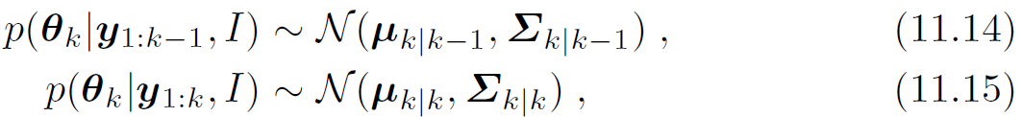
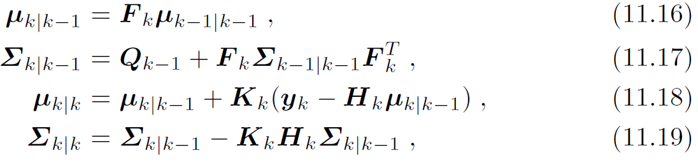
the predicted pdf (11.2) and the a posteriori pdf (11.1) are Gaussian:
where
and K_{k} is the Kalman gain matrix,
Rewrite (11.19) for reasons of numerical stability as

Slide 15
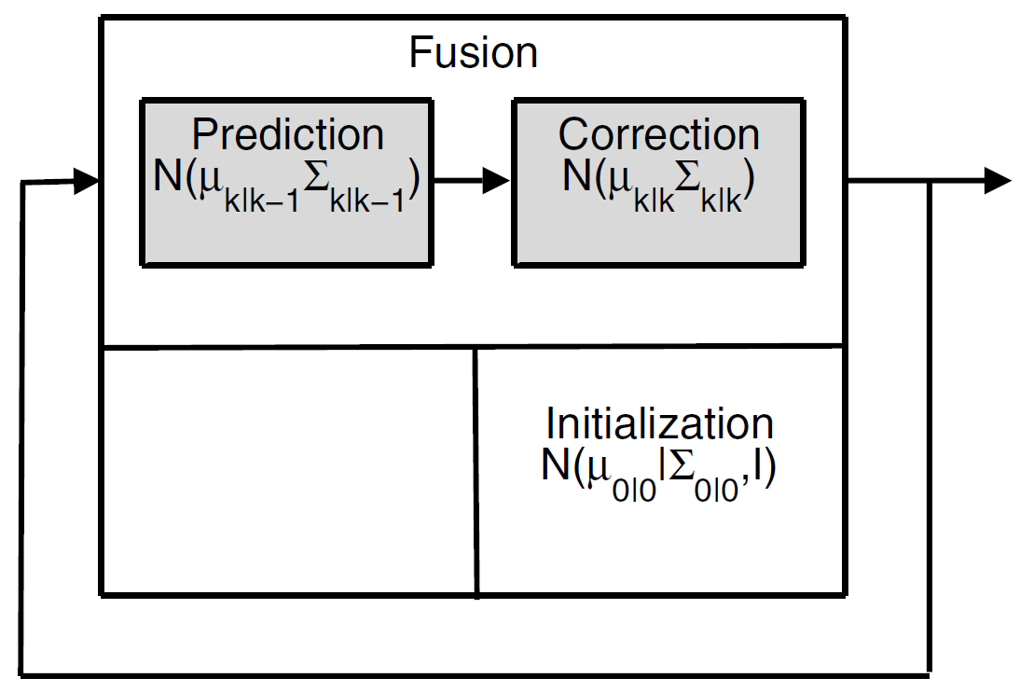
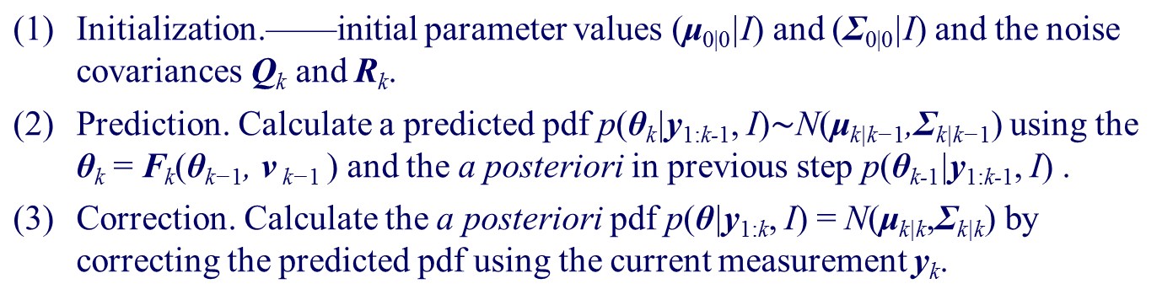
Main processing steps in the KF.

Slide 16
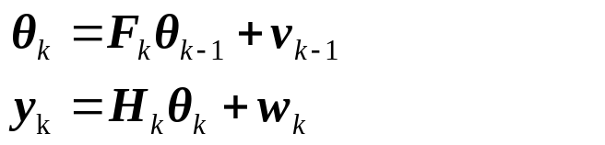
KF used to track a well-defined object
Example 11.2. Tracking a Satellite’s Orbit Around the Earth.
The unknown state θ_{k} —— the position and speed of the satellite at time step k with respect to a spherical coordinate system with origin at the center of the earth.
Measurements y_{k} ——the distance to the satellite and the accompanying angles;
H_{k} —— the geometrical principles of mapping y_{k} into θ_{k}, while w_{k} reflects the measurement error;
F_{k} —— prescribes how the position and speed change in time according to the physical laws governing orbiting bodies, while v_{k} allows for deviations from these laws owing to such factors as nonuniformity of the earth’s gravitational field etc.
□

Slide 17
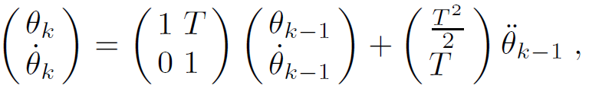

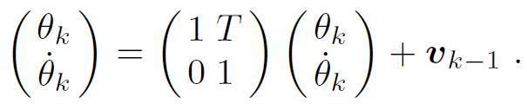
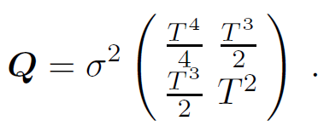
Example 11.3. Tracking a Moving Target.
Consider a target moving in one-dimension at a nominal constant velocity while being subjected to stochastic accelerations.
Matrix equation of motion of the target is:
θ_{k} —— the true position of the target at the kth time step
T —— the interval between successive time steps.
Process model is:
Process noise : v_{k−1} ∼ N(0,Q).
□

Slide 18
KF used to track objects which are not well-defined
Example 11.4. Tracking Meteorological Features.
In general meteorological features, such as storm centers, are not well-defined.
In addition, individual storms rarely satisfy the linear-Gaussian assumption of the KF.
Nevertheless, in practice [192], the KF has been used to track storm centers with reasonable accuracy.
□

Slide 19
11.3.1 Parameter Estimation （参数估计）
For a KF, the parameters μ_{0|0}, Σ_{0|0}, Q_{k} and R_{k} which must be defined before running the filter.
the values chosen for μ_{0|0} and Σ_{0|0} do not seriously affect the medium and long term results obtained with the filter, i. e. the values μ_{k|k} and Σ_{k|k} for k >> 0.
often use simple a priori values for μ_{0|0} and Σ_{0|0} or a track initiation filter.
The way that Q_{k} and R_{k} are specified crucially affects μ_{k|k} and Σ_{k|k} . In mathematical terms, the values of Q_{k} and R_{k} affect the Kalman gain K_{k} which in turn affects the capability of the filter to adjust itself to changing conditions.

Slide 20
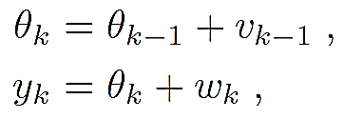
Example 11.5. Correcting near surface temperature forecasts using a Kalman filter.
Numerical weather prediction models often exhibit systematic errors in the near surface temperature forecast T .
Let the measurement y_{k} be the difference between an observed temperature and the weather prediction model forecast and let the state vector θ_{k} be the systematic part of this error. We assume the changes in θ_{k} are random.
The corresponding process and measurement models are then

Slide 21
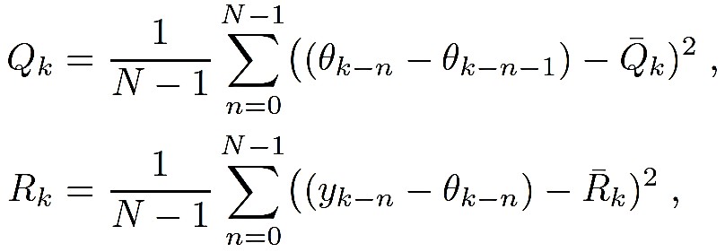
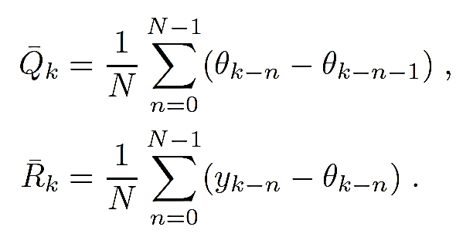
Q_{k} and R_{k} can be estimated by using the sample variances of the N latest v_{k−n} = θ_{k−n} −θ_{k−n−1} and w_{k−n} = y_{k−n} − θ_{k−n} values:
where
□

Slide 22
11.3.2 Data Association （数据关联）
data association problem
The presence of spurious measurements creates an ambiguity regarding the origin of the measurements, i. e. it is often not clear which measurement corresponds to the system (a “true”measurement) and which measurement corresponds to clutter (a “false” measurement) .
hard or soft solution
hard —— We assign a given measurement to the system. θ_{k} is updated assuming that the assigned measurement is the true measurement.
Soft —— We assign more than one measurement to the system, each measurement having its own assignment probability. We use each measurement which has an assignment probability greater than zero to update θ_{k}.

Slide 23

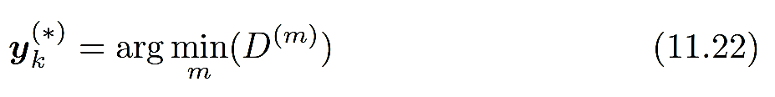

Nearest Neighbor Filter（最邻近滤波器）
Assumes the measurement that is closest to the predicted state of the system is the true measurement.
For the set of M_{k} measurements received at time step k
We assume the true measurement is
where

Slide 24
Performance
If the true measurement is not detected at time step k, then the nearest neighbor will always be a false measurement which may cause erratic behavior in the KF.
In the modified nearest neighbor rule, we only use validated measurements, i. e. measurements y_{k} ^{(∗)} for which D ^{(∗)} ≤ γ, where γ is a given threshold.
In general, the performance of the NN and the validated NN algorithms is low.

Slide 25
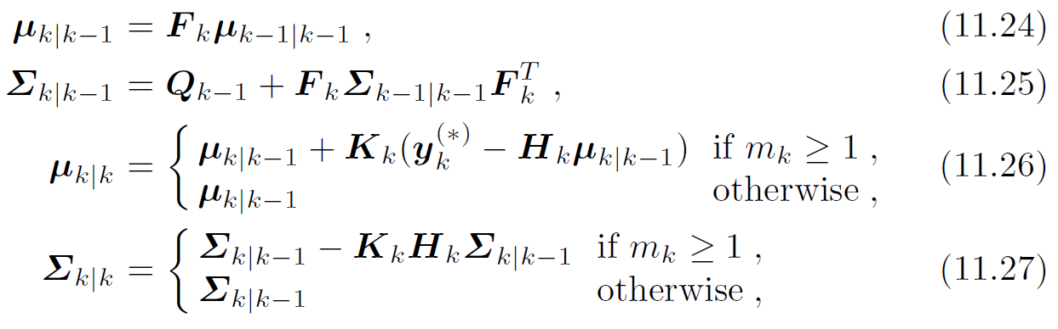
Nearest neighbour filter combines the KF with a validated NN solution
where m_{k} is the number of validated measurements at time step k, and

Slide 26
Strongest Neighbour Filter（最强邻近滤波器）
Assumes the measurement with the largest validated amplitude is the true measurement.
We restrict ourselves to validated measurements.
In general, the performance of the SN algorithms are better than the NN algorithms but worse than PDA algorithm.
Example 11.6. A Probabilistic Strongest Neighbour Filter for Tracking in Clutter.
We weight the strongest neighbor measurement (in the validation gate) with the probability that it is the true measurement.
This is in opposition to the SN filter which makes the unrealistic assumption that the SN measurement is always the true measurement.
The result is a filter which has substantially better performance than the NN, SN and PDA filters.

Slide 27
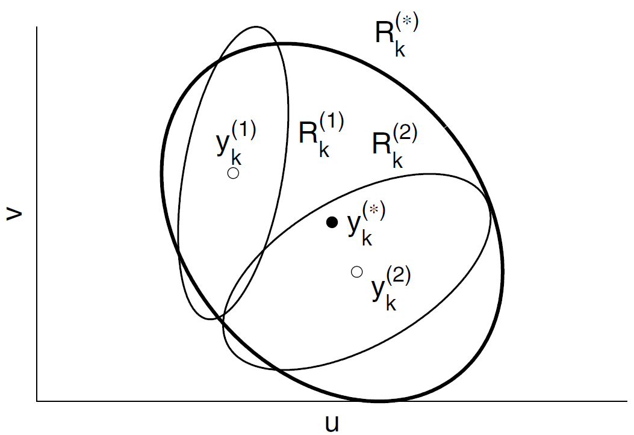

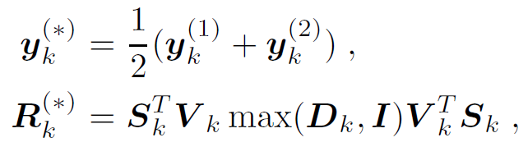

Covariance Union Filter（协方差合集滤波器）
The measurement which is selected by the covariance filter is a “pseudo” measurement characterized by a “pseudo” value y_{k}^{(∗)} and a “pseudo” covariance matrix Σ_{k}^{(∗)} which are chosen to be consistent with all validated measurements.
where S_{k} = |R_{k}⁽²⁾|^{1/2}, and max(A,B) denotes the element-by-element maximum of the matrices A and B, and V_{k} and D_{k} are, respectively, the matrices of the eigenvectors and eigenvalues of

Slide 28

Probabilistic Data Association Filter（概率数据关联滤波器）
The probabilistic data association (PDA) filter uses all of the validated measurements, y_{k}^{(m)} ,m ∈{1, 2, . . .,m_{k}}, and their probabilities β^{(m)} to update θ_{k}.
Each y_{k}^{(m)} is given a weight β^{(m)} which is the probability that y_{k}^{(m)} is the true measurement.
Also we compute a weight β⁽⁰⁾ which is the probability that none of the validated measurements are the true measurement.
These events encompass all possible interpretations of the data, so
The state of the system is separately updated using each validated measurement in turn. The collection of updated states are then combined together to form the final state of the system.

Slide 29
11.3.3 Model Inaccuracies （模型不准确性）
In the KF we model the system using a linear Gaussian process model and a linear Gaussian measurement model.
When the conditions are far from Gaussian, the KF can often give sensible results by giving more weight to the input measurements, i. e. by increasing the processes noise covariance Q.

Slide 30
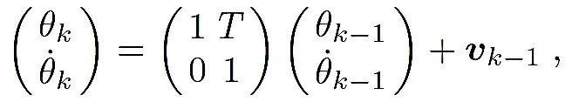
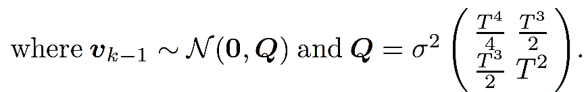
Example 11.7. Maneuvering Target（机动目标）.
For a target moving in one-dimension with a nominally constant velocity which is subject to stochastic accelerations, the corresponding process model (see Ex. 11.3) is
If the target initiates and sustains a driver-induced maneuver, then we use a maneuver detector.
Once a maneuver has been detected, we should initialize a new recursive filter whose process model describes target maneuver.

Slide 31
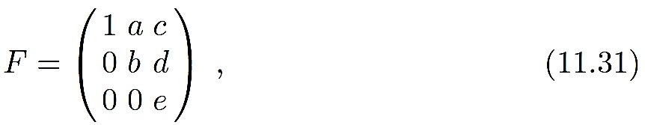
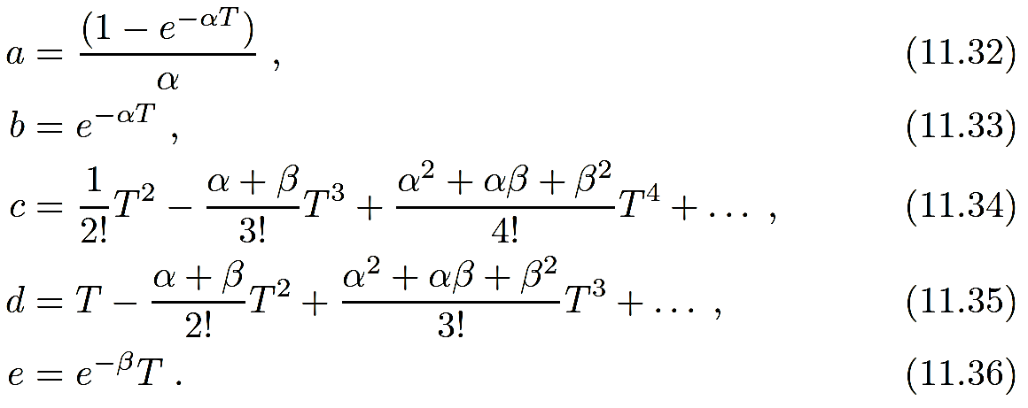
A general one-dimensional maneuver model:
in which both the target velocity and acceleration are described by zero-mean first-order Markov processes, where
and α = 1/τ_{v} and β = 1/τ_{a} are, respectively, the reciprocal of the velocity and acceleration correlation times.

Slide 32
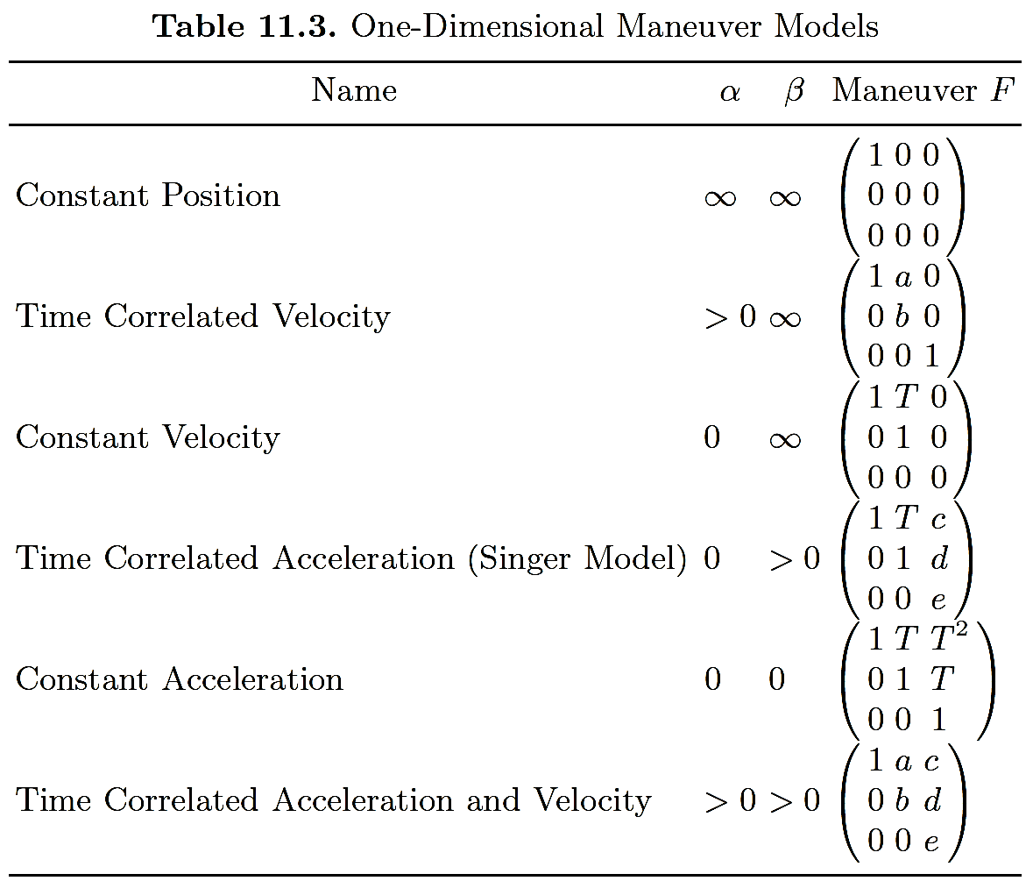

Slide 33
11.3.4 Multi-Target Tracking（多目标跟踪）
If the targets are widely separated one from the other —— we track the targets using a separate KF for each target using the NN, SN, CU or PDA filters.
In most real-world systems, the targets are not sufficiently separated and modified tracking/data association algorithms must be used.

Slide 34
11.6 Multi-Sensor Multi-Temporal Data Fusion
（多传感器多时相数据融合）
Consider several sequences of measurements y_{1:k}^{(m)}, m∈{1, 2, . . .,M}, each sequence y_{1:k}^{(m)} being made with a different sensor S^{(m)}.
Measurement Fusion（测量融合）: we place all the measurements y_{k}^{(m)} , m∈{1, 2, . . ., M}, obtained at time step k into a single augmented measurement vector. We then fuse the vector using a single recursive filter.
Track-to-track fusion（航迹-航迹融合）: we separately filter the measurements received from each sensor and then fuse the results together.

Slide 35


11.6.1 Measurement Fusion （测量融合）
Measurement Fusion: we place all the measurements y_{k}^{(m)} , m∈{1, 2, . . ., M}, obtained at time step k into a single augmented measurement vector
We then fuse the using a single recursive filter.

Slide 36
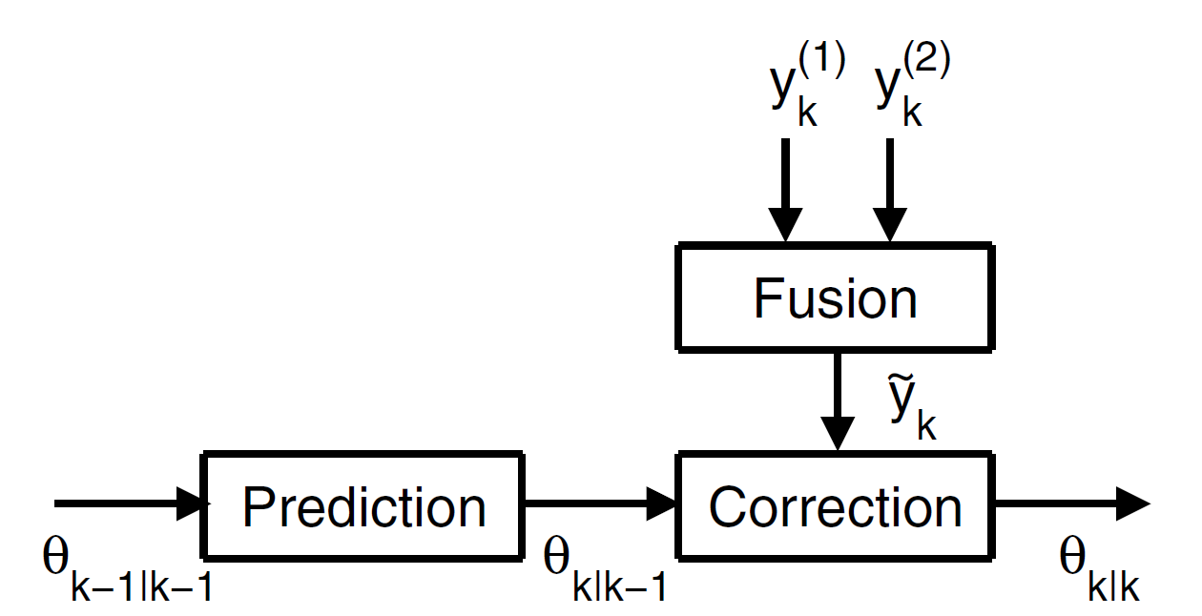
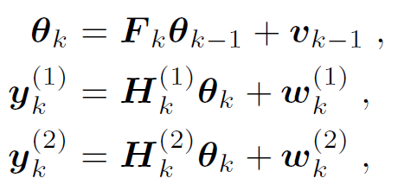
Example 11.11. Multi-Sensor Multi-Temporal Data Fusion: Measurement Fusion.
We consider the tracking of a single target. Let θ_{k} denote the filtered state of the target at time step k and y_{k}^{(m)} denotes the corresponding measured position of the target as recorded by two sensors S⁽¹⁾ and S⁽²⁾.
The process and measurement equations are:

Slide 37

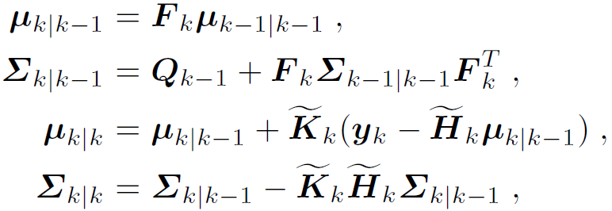
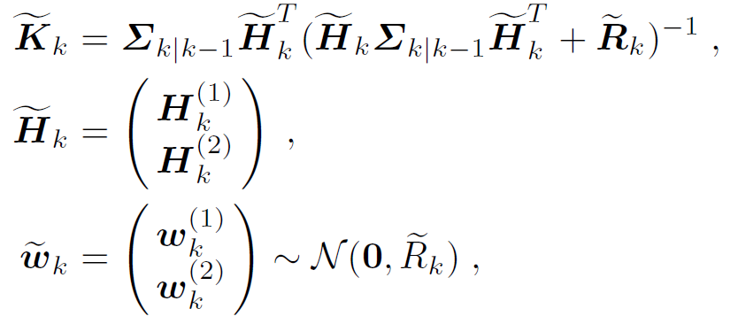
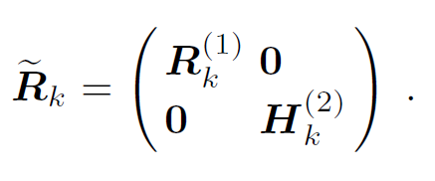
We estimate using the KF equations:
where
Note: measurement fusion requires a centralized architecture —— it is sensitive to errors involved in forming a common representational format.

Slide 38

11.6.2 Track-to-Track Fusion （航迹-航迹融合）
We first perform multi-temporal fusion using M recursive filters, in which the mth filter fuses the measurements y_{1:k} ^{(m)} = {y₁^{(m)} , y₂^{(m)}, . . . , y_{k}^{(m)}} made by the mth sensor S^{(m)}
→the corresponding a posteriori pdf
we fuse together the M a posteriori pdf’s using a linear least squares (minimum mean square error) estimate.

Slide 39
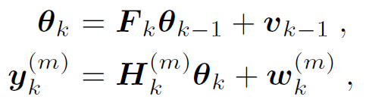


Example 11.12. Multi-Sensor Multi-Temporal Data Fusion: Track-to-Track Fusion.
We re-analyze Ex. 11.11 using the Bar-Shalom-Campo track-to-track fusion algorithm.
Let θ_{k} denote the filtered state of the target at time step k, and y_{k}^{(m)} denotes the measured position of the target as recorded sensors S^{(m)} .
The process and measurement equations are:
where
For each sensor, we conduct KF estimate of state θ_{k} given the sensor measurements y_{k}^{(m)} :

Slide 40
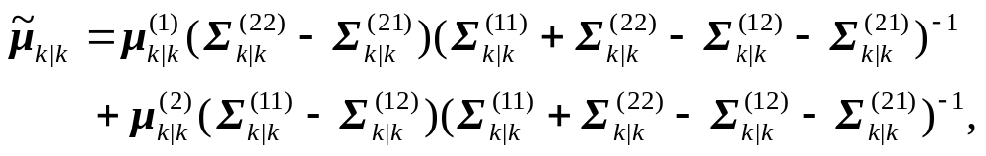
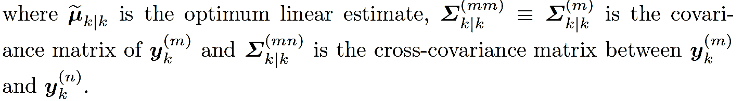
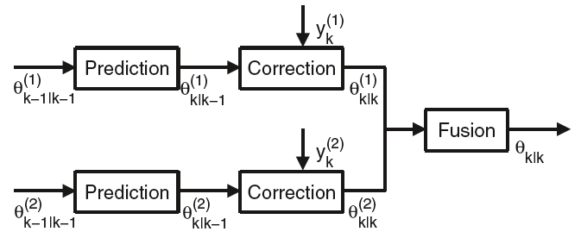
For M = 2 we fuse together the two (correlated) estimates
m∈{1, 2}, using the Bar-Shalom-Campo formula:

Slide 41

Thank you for your attention!

